Slide 1
Do not reinvent the wheel, try to find new applications for it
Label-based Access Control for More Flexible Privacy Setting and Options for OSN Users
Presented by: Leila Bahri
Affiliation: Insubria University
iSocial periodic meeting
Milan
January 2016

Slide 2
Quick Outline
What privacy settings look like in today’s OSNs; a zoom on Facebook
What are the limitations we observe
How we suggest addressing them
Conclusions

Slide 3
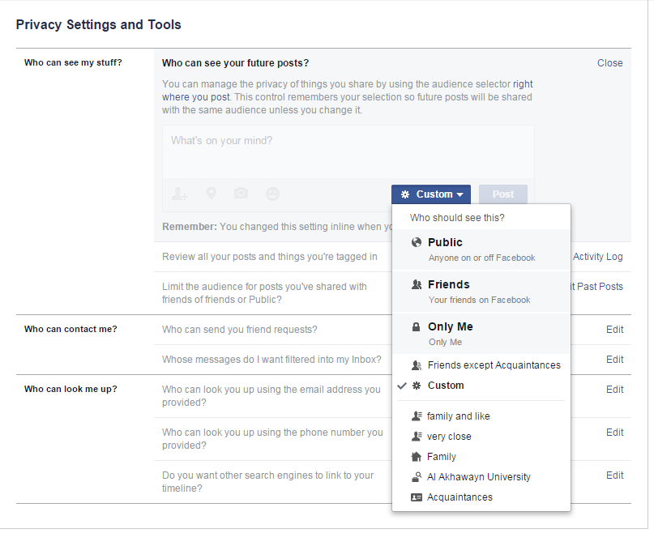
Current Privacy Settings (PS)
Let’s talk Facebook …

Slide 4
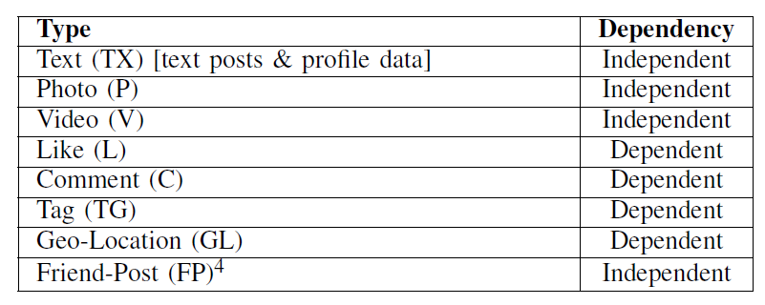
Current Privacy Settings (PS)
How does it work?
Users generated content can be classified under one of these types:
⁴ A friend-post (FP) type refers to content generated by a user on the profile (wall) of a friend.

Slide 5
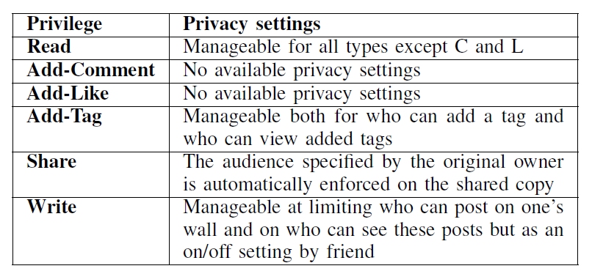
Current Privacy Settings (PS)
How does it work?
Users generate content and interact on generated content by their friends. Setting privacy limitations is possible, but not all options are available on all the types and/or interactions:

Slide 6
What is the problem?
Can we set Privacy Settings (PS) on comments?
Can we restrict the audience of a like we make?
Can we classify users within the same group?
…

Slide 7
What we suggest …
Deploy label-based access control to provide more flexible privacy settings and options.
What is label-based access control (LBAC)?

Slide 8
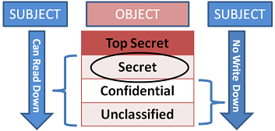
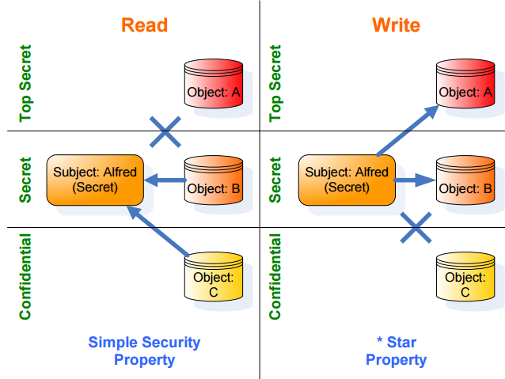
LBAC comes from Mandatory Access Control (MAC)
Mandatory Access Control by Bell and LaPadula:
A state machine model for information flow and access control
Bases on classifying subjects and objects
Operates with two main properties: simple security property & start property

Slide 9
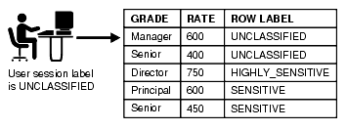
LBAC is a more flexible adoption of MAC
A form of ‘decentralized’ Mandatory Access Control deployed within a well scoped framework
Allows sub-admins to label data at finer granularity
AC is managed based on ordering relationships between users’ and objects’ labels
Example extracted from Oracle OLS documentation @ http://docs.oracle.com/cd/B19306_01/network.102/b14267/intro.htm

Slide 10
LBAC for OSNs - Challenges
In OSNs,
there is not only read and write! – there is also tag, comment, share, like, etc
objects are collaboratively created → common ownership
no-read up & no-write down are not sufficient to cover OSN’s domain specific use case scenarios

Slide 11
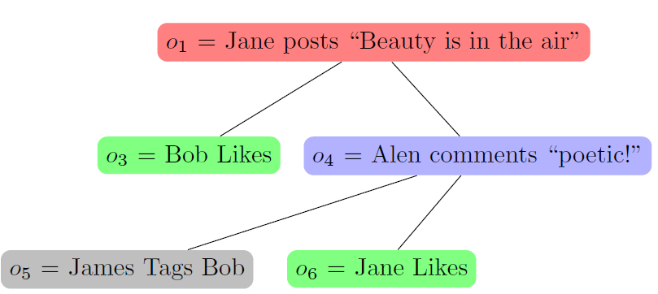
LBAC for OSNs – Complex data ownership
Object Type | Owner | Privacy Prefrerence
O1 = text post | Jane | public
O3 = a like | Bob | All-friends
O4 = a comment | Alen | Custom
O5 = a tag | James? (Bob) | Only me

Slide 12
LBAC for OSNs vs. Current PS – Basic Picture
Family
Security Label
Clearance = Low
Objects = photo, video
Groups = family
Sensitivity Label
Sensitivity= High
Type = photo
Groups = family
Mike
Dima
Mike
Alen
Security Label
Clearance = V.High
Objects = all
Groups = all
Alen
Sensitivity Label
Sensitivity= High
Type = video
Groups = all
Javier
Lina
Dima
colleagues
Alen
Alen’s objects
Security Label
Clearance = High
Objects = all
Groups = sport-mates
Javier
Only family members (but all of them) will access photos
Only colleagues (but all of them) will access the video
Alen’s friends
Mike and Javier will not see Alen’s photo, only Dima can gain access to it
Mike, Dima, and Javier will all access Alen’s video

Slide 13
What about a share?
Mike
Security Label
Clearance = Low
Objects = photo, video
Groups = family
Alen
Dima
Lina
Mike
Sample OSN
Javier
Security Label
Clearance = V.High
Objects = all
Groups = all
Dima
Security Label
Sensitivity= High
Type = photo
Groups = family
Alen
Javier
Security Label
Clearance = High
Objects = all
Groups = sport-mates
Alen
Security Label
Sensitivity= High
Type = video
Groups = all
Security Label
Clearance = V.H
Objects = photo
Groups = family
What could be the problem if Dima shares Alen’s photo?
Mike
Security Label
Clearance = H
Objects = photo
Groups = family
Dima
Lina
Security Label
Clearance = H
Objects = photo
Groups = family
Alen

Slide 14
Our solution works on three designed properties
Fundamental security property (FSP)
Manages read privileges
Share Higher Property (SHP)
Manages share actions
Write Higher Property (WHP)
Manages writing privileges on others’ spaces (including tagging someone else in a photo)

Slide 15
Dominance relationship between labels
A friend-label (FL) dominates an object-label (OL) if:
FL.clearence >= OL.sensitivity, and
FL.objects contains OL.type , and
FL.groups and OL.groups have at least one group in common
Security Label
Clearance = Low
Objects = photo, video
Groups = family
Security Label
Sensitivity= High
Type = photo
Groups = family
Mike
Security Label
Clearance = V.High
Objects = all
Groups = all
Security Label
Sensitivity= High
Type = video
Groups = all
Dima
Alen
Alen
Javier
Security Label
Clearance = High
Objects = all
Groups = sport-mates
Dima’s label dominates Alen’s photo’s label
Mike’s label does not dominate Alen’s photo’s label

Slide 16
Fundamental security property (FSP)
FSP statement: for any requested privilege that is, a read, share, add-like, or add-comment, the privilege can be granted only if the friend label of the requesting user dominates the label assigned to the target object.
Security Label
Clearance = Low
Objects = photo, video
Groups = family
Mike
Security Label
Sensitivity= High
Type = photo
Groups = family
Security Label
Clearance = V.High
Objects = all
Groups = all
Dima
Alen
Security Label
Sensitivity= High
Type = video
Groups = all
Alen
Javier
Security Label
Clearance = High
Objects = all
Groups = sport-mates

Slide 17
Share Higher Property (SHP)
SHP statement: a friend can share another friend’s object only if she assigns to the shared copy does not declassify the label assigned to the original object.
Security Label
Clearance = Low
Objects = photo, video
Groups = family
Mike
Security Label
Sensitivity= V.H
Type = video
Groups = family
Security Label
Sensitivity= High
Type = photo
Groups = family
Security Label
Clearance = V.High
Objects = all
Groups = all
Dima
Alen
Security Label
Sensitivity= High
Type = video
Groups = all
Alen
Security Label
Clearance = V.H
Objects = photo
Groups = family
Security Label
Clearance = High
Objects = all
Groups = sport-mates
There is an undesired disclosure!
Javier
Mike
Security Label
Clearance = H
Objects = photo
Groups = family
Dima
Lina
Security Label
Clearance = H
Objects = photo
Groups = family
Alen

Slide 18
Horizontal disclosures, how to prevent?
Security Label
Sensitivity= High
Type = photo
Groups = family
Security Label
Sensitivity= V.H
Type = video
Groups = family
Security Label
Clearance = Low
Objects = photo, video
Groups = family
Mike
Alen
Security Label
Sensitivity= High
Type = video
Groups = all
Security Label
Clearance = V.High
Objects = all
Groups = all
Dima
Alen
Javier
Security Label
Clearance = High
Objects = all
Groups = sport-mates
Security Label
Clearance = V.H
Objects = photo
Groups = family
Mike
Security Label
Clearance = H
Objects = photo
Groups = family
Dima
Lina
Security Label
Clearance = H
Objects = photo
Groups = family
Alen

Slide 19
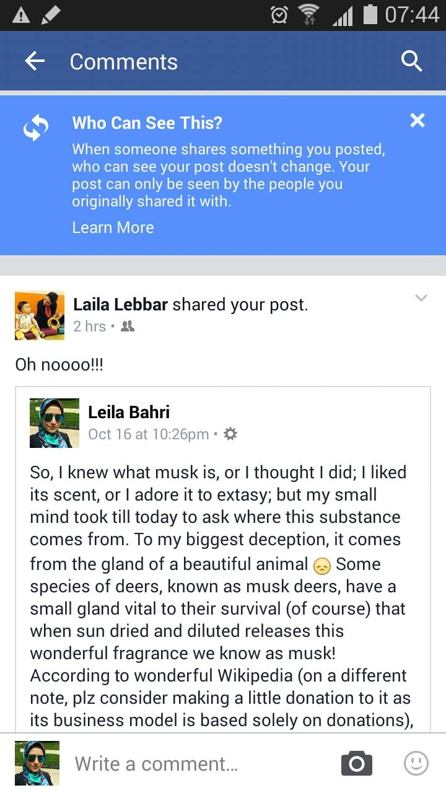
How shares are now managed in Facebook?
What is the aim of a “share” then?!

Slide 20
Write Higher Property (WHP)
WHP statement: for a requested privilege of a write or an add-tag, the request can be granted only if the sensitivity level in the label assigned to the resulting object is at least equal to the clearance level assigned to the requesting user.
Security Label
Clearance = Low
Objects = photo, video
Groups = family
Example:
Mike wants to post a photo on Alen’s wall.
The security label of this photo that satisfies the WHP is:
Mike
Security Label
Clearance = V.High
Objects = all
Groups = all
Dima
Alen
Security Label
Sensitivity= H
Type = photo
Groups = family
Javier
Security Label
Clearance = High
Objects = all
Groups = sport-mates

Slide 21
What are the gains?!
Number of operations to set privacy limitations on a friend or on an object in Facebook Privacy Setting interface (FPS) vs. in our suggested method, UPPLA

Slide 22
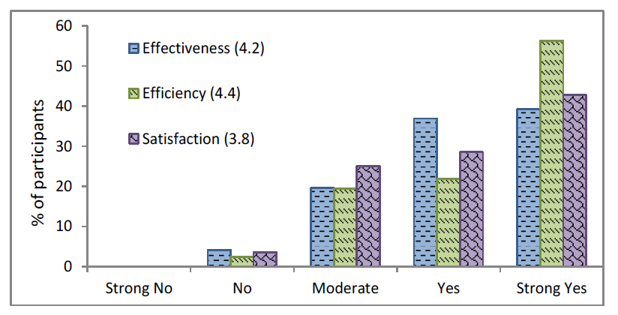
Preliminary experiments
Reported satisfaction on UPPLA based on feedback from 26 participants who used UPPLA app to label friends (avg = 10) and objects (avg = 4)

Slide 23
Conslusions
Adapting label-based access control provides more flexibility in available options to users for setting their privacy
UPPLA, our suggested solution, cuts down the number of operations to be performed by users to set privacy on their friends and objects
HOWEVER:
Usability is an important aspect that has to be studied more deeply
Developing models for automatic labelling would definitely strengthen the solution
UPPLA offers a mechanism for more privacy setting options, but easiness of adoption should be further studied!

Slide 24
Thank you for your kind attention ☺ I will be available for questions after your lunch break Buon Appetito!

